Slide 1
LIMBIC SYSTEM
Dr Reshmy K.R
Professor
Dept. of Physiology
SKHMC

Slide 2
The limbic lobe is a complex set of C-shaped structures containing both gray and white matter.
It lies deep within the brain and includes portions of all the lobes of the cerebral hemispheres.
A myriad of fiber tracts connect the limbic lobe with numerous deep nuclei and the olfactory apparatus to form the limbic system.
Phylogenetically, the limbic system is one of the more primitive parts of the brain.
It has a central role in memory, learning, emotion, neuroendocrine function, and autonomic activities.
Clinical conditions involving the limbic system include epilepsy, congenital syndromes, dementias, and various psychiatric disorders.

Slide 3
The entire neuronal circuitry that controls emotional behavior and motivational drives
It is a complex system of cortical and subcortical structures that form a ring around the hilus of the cerebral hemispheres.
limbus means 'ring'

Slide 4
A complex set of interconnected brain areas that integrate information about sensory stimuli, memories, and cognitive plans to produce emotional learning and emotional experience.
In 1937, Papez proposed that the part of the cortex dedicated to processing emotion is the limbic lobe, as defined by Broca.
The limbic lobe comprises a ring of “primitive” cortex around the brainstem, including the cingulate cortex, the parahippocampal gyrus, and the hippocampal formation.

Slide 5
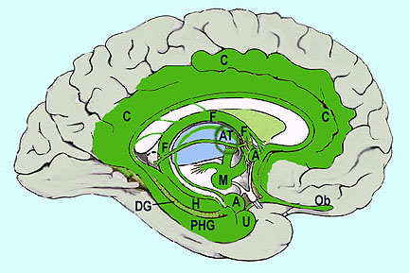
Limbic System
Cingulum and cingulate gyrus
Fornix
Ant nucl thalamus
Mamillary body
Fornix
Ant nucl thalamus
Mamillary body
Hippocampus
Dentate gyrus
Parahippocampal gyrus
Amygdala

Slide 6
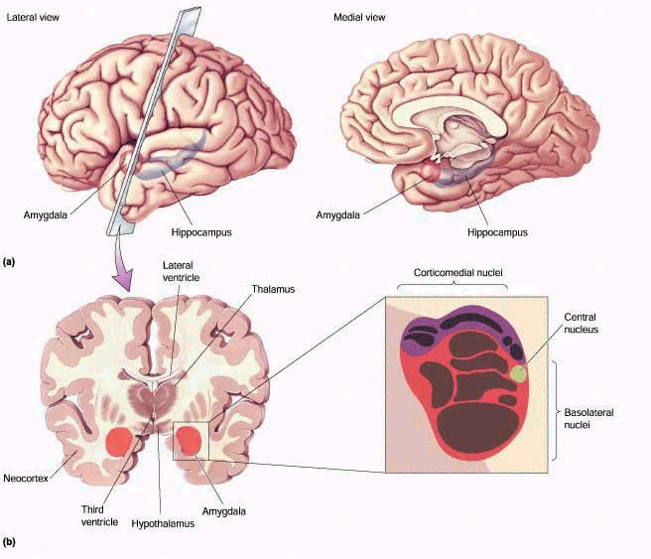
components
1. Archicortical structure
2. Paleocortical structure
3. Juxtallocortical structures
4. Subcortical structures

Slide 7
Archicortical structure
Hippocampus
Dentate gyrus

Slide 8
Paleocortical structure
Pyriform cortex
Olfactory bulb
Olfactory tubercle

Slide 9
Juxtallocortical structures
1. Cingulate gyrus/ limbic cortex
2.Orbitoinsulotemporal cortex

Slide 10
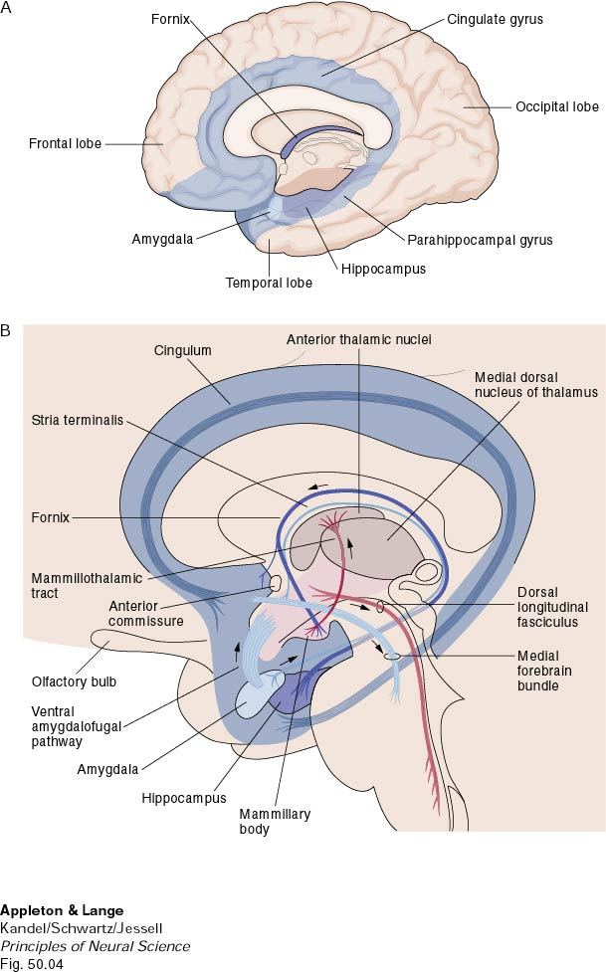
Subcortical structures
1.Amygdaloid complex
2.Septal nucleus
3.Thalamic nucleus
4.Hypothalamic nucleus
5.Caudate nucleus
6.Reticular formation of midbrain

Slide 11
Connections
1. Fornix
Fibers connecting hippocampus and septal nucleus with the mamillary body
Hippocampus with hypothalamic nuclei

Slide 12
2. Lateral hypothalamus receives afferent fibers from
hippocampus
septal nuclei
olfactory tubercle
head of caudate nucleus
pyriform area
periamygdaloid area

Slide 13
3. Caudate nucleus receives fibers from
cingulate gyrus
intra laminar nuclei of thalamus

Slide 14
4. Brain stem reticular formation receives fibers from
hippocampus
cingulate gyrus

Slide 15
5. Papez circuit
It is the interconctions between various structures of limbic system, which forms a complex of closed circuit

Slide 16
1.Hippocampus FORNIX
mamillary body of hypothalamus
2.Mamillary bodies MAMILLOTHALAMIC TRACT
Ant. nucleus of thalamus

Slide 17
3. Ant. thalamic nucles
MEDIAL THALAMOCORTICAL FIBERS
Cingulate gyrus
4.Cingulate gyrus
CRTICOHIPPOCAMPAL FIBERS
Hippocampus

Slide 19
Hypothalamus represents less than 1%of the brain mass.
It is one of the most important of the control pathways of the limbic system.
It controls most of the Vegetative and Endocrine functions of the body as well as many aspects of Emotional Behavior
Limbic structures and hypothalamus are highly interconnected with each other and with cortex and brainstem

Slide 20
“Reward” and “Punishment” Function of the Limbic System
The limbic structures are concerned with the affective nature of sensory sensations – that is, whether the sensations are pleasant or unpleasant or also called reward or punishment or satisfaction or aversion

Slide 21
The major reward centers are located along the course of the medial forebrain bundle, especially in the lateral and ventromedial nuclei of the hypothalamus
weaker stimuli gives a sense of reward, and stronger ones a sense of punishment
Less potent reward centers – septum, amygdala, certain areas of the thalamus and basal ganglia

Slide 22
punishment centre
Most potent areas have been found in the central gray area surrounding the aqueduct of Sylvius in the mesencephalon
Less potent punishment areas are found in the amygdala and hippocampus
Stimulation in these areas causes the animal to show all signs of displeasure, fear, terror, pain and even sickness.

Slide 23
Hippocampus:
learning and declarative memory
– memory for facts, events, faces, places etc.
Amygdala:
learning and memory of emotional significance of stimuli

Slide 24
The amygdala the key coordinator, linking cortical processing to the hypothalamus and other subcortical brain structures important for emotional behavior.

Slide 25
FUNCTIONS OF LIMBIC SYSTEM
Olfaction -pyriform nucleus, amygdaloid nucleus
regulation of endocrine glands- hypothalamus
regulation of autonomic functions like heart rate,B.P, water balance, bdy temperature
regulation of food intake-feeding & satiety centre of hypothalamus with amygdaloid complex
control of circadian rhythm- hypothalamus
regulation of sexual function-hypothalamus
role in emotional state-hyppocampus with hypothalamus
role in memory- hyppocampus& Papex circuit
role in motivation- reward& punishment centres of hypothalamus, limbic system

Slide 26
Kluver-Bucy Syndrome
The amygdala in humans has been linked to emotional processing
The first good evidence linking the amygdala and related temporal lobe structures to emotion was obtained in 1939 by Heinrich Kluver and Paul Bucy.
They removed the temporal lobes, including the amygdala and hippocampus, bilaterally in monkeys.
They observed a dramatic change in emotional behavior:
Monkeys became tame, fearless, and had “blunted” emotions
Increased oral activity, including placing inedible objects in their mouth.
They exhibited increased sexual behavior, mounting inappropriate objects.
Subsequent studies that made more precise lesions indicate that the amygdala was a key structure mediating the emotional effects.

Slide 27
Studies showes
The amygdala has been implicated in playing a prominent role in integrating information and coordinating emotional behaviors in response to sensory stimuli, events, and memories.
These findings were demonstrated in:
Fear conditioning studies in rodents
Monkey studies (Kluver-Bucy)
Human neuroimaging and lesion studies
Studies of memory modulation by hormones in lower animals.
Reward processing occurs in distinct brain circuits.
Stimulation of these circuits can provide powerful reinforcement signals.
Dopaminergic neurons in the ventral tegmental area provide a learning signal that reflects a computation comparing the reward received to the reward expected.
Drugs of abuse act on reward circuits.
Psychiatric disorders such as depression, anxiety disorders, and addiction, all involve limbic system neural circuitry.

Slide 28
Kluver-Bucy Syndrome

Slide 29
Reference
http://thinktankcentre.blogspot.com/2015/08/the-limbic-system.html
https://www.slideshare.net/rongon28us/5-limbic-system
https://sites.google.com/site/hookappsychology1b/limbic-system
Thank You

